Slide 1
WONDERS OF THE WORLD
Group 1
Benjamín Alcázar Muñoz
Manuel Delicado Ortiz
Inmaculada Garrido Castellanos
Carlos Patiño García
6TH LEVEL
PRIMARY EDUCATION

Slide 2
CHANT

Slide 3
Children, you are boys in a big city walking in the streets in different countries, you are happy, it’s in your face , it is great!
Take my hand we will visit a place.
Nile is the longest river, river!
Everest is the highest mountain, mountain!
Children, you are boys in a big city walking in the streets in different countries, you are happy, it’s in your face , it is great!
Take my hand we will visit a place.
Australia is the biggest island, island!
Sahara is the hottest desert, desert!
Children, you are boys in a big city walking in the streets in different countries, you are happy, it’s in your face , it is great!
Take my hand we will visit a place.

Slide 4
Create a new chorus.
Children, you are boys in a big city walking in the streets in different countries, you are happy, it’s in your face , it is great!
Take my hand we will visit a place.
________________________________
________________________________
Children, you are boys in a big city walking in the streets in different countries, you are happy, it’s in your face , it is great!
Take my hand we will visit a place.
________________________________
________________________________

Slide 5
You can use...
deep
Paris
dry
beautiful
long
waterfall
building
ocean
Empire State

Slide 6
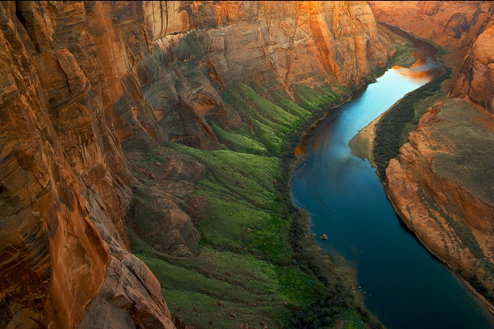
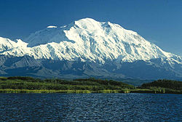
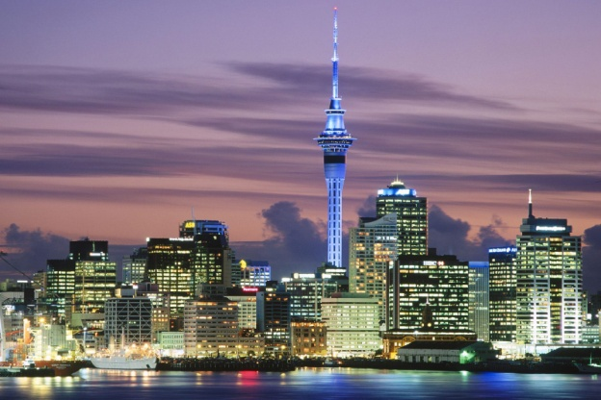
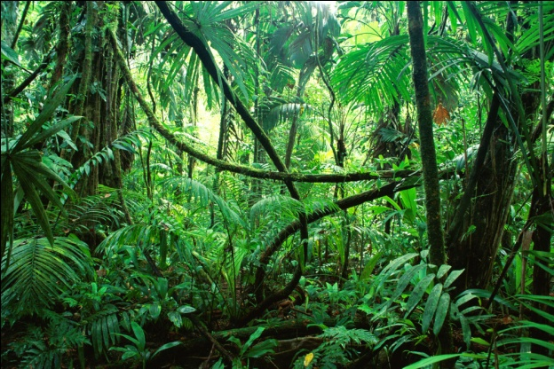
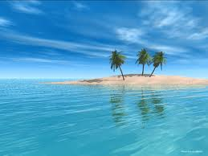
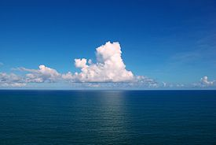
River
Mountain
City
Rainforest /Jungle
Island
Sea / Ocean

Slide 7
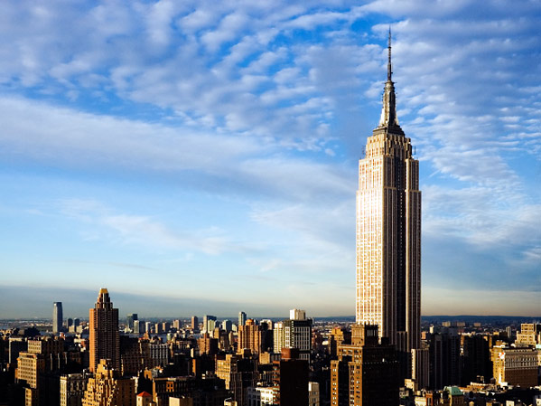
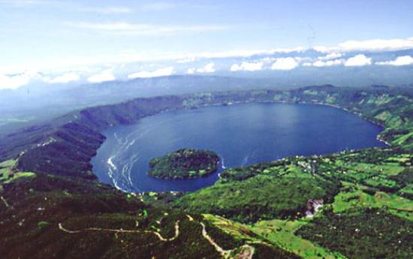
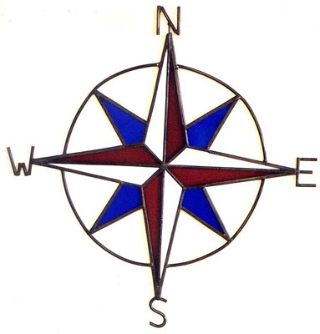
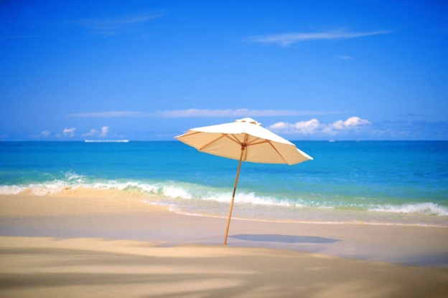
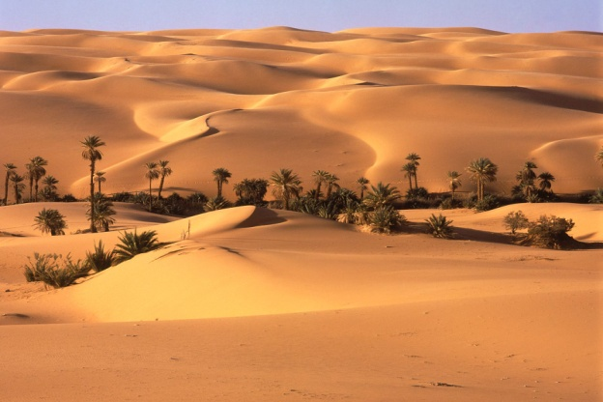
North
Building
Lake
West
East
South
Beach
Desert

Slide 8
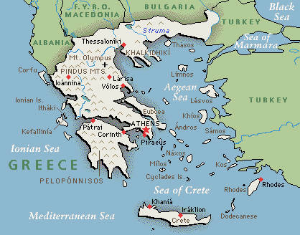
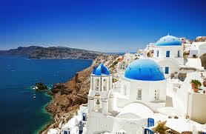
LET’S KNOW GREECE!
Read this tourist leaflet about Greece.
Greece is in the South-East of Europe.
Greece has the longest coastline in Europe, but other European countries like France or Poland are bigger than Greece.
It is well known for its thousands of islands. Crete is the biggest island.
Santorini is smaller than Crete, but it is the most beautiful island.
Mount Olympus is the highest mountain.
Greek capital city is Athens. It is the largest and most important city.

Slide 9
Answer these questions and put them in order.
4
3
Athens is the _________ of Greece.
Which is the biggest Greek island?
a) Capital city
a) Santorini
b) Longest river
b) Mount Olympus
c) Smallest city
c) Crete
1
2
Where is Greece situated?
Greece is ______ than France.
a) In the North of Europe
a) Bigger
b) In the South-East of Europe
b) Higher
c) In the South of America
c) Smaller

Slide 10
Let’s check the answers.
1
Amazon is _________ than Nile.
a) Shorter
b) Higher
2
c) Smaller
If you are in Asia you can see ____________ in the world.
a) The largest jungle
b) The hottest desert
c) The highest mountain

Slide 11
3
A place surrounded by water is called...
a) Lake
b) Island
c) Beach
4
It is a natural place which is higher than a tree.
a) Beach
b) Building
c) Mountain
5
Antarctica is in the _______ of the world.
a) South
b) North
c) West

