Slide 1
Hello song
Hello! Hello! Hello, how are you?
I’m good! I’m great! I’m wonderful! x2 Hello! Hello! Hello, how are you?
I’m tired. I’m hungry. I’m not so good. x2
Hello! Hello! Hello, how are you?
x2

Slide 2
Activities with flashcards
Dogs and cats: Children are sitting in circle. The teacher gives a flashcard to each child. There will be repeated flashcards. The teacher says, for example “ice-cream”, and the children who have this flashcards have to run in circle to catch the others children who are running and they have to try not to be caught.

Slide 3
STORY

Slide 5
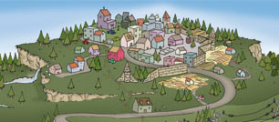
An old man came upon a village. As he entered, the villagers were afraid and locked their doors and windows.

Slide 6
The old man smiled and asked, “why are you all so frightened? I am a simple traveler, looking for a place to stay for the night and a meal”.

Slide 7
"There's nothing to eat in the village," the villagers told him. "We are poor and our children are hungry”.
"Oh, I have everything I need," he said. "In fact, I was thinking of making some stone soup to share with all of you." He took an iron cauldron, filled it with water, and began to build a fire under it.

Slide 8
Then, he took a stone from his bag and dropped it into the water.

Slide 9
By now, hearing the rumor of food, the villagers came out of their homes.
"Ahh," old man said “ Delicious! Would you have some cabagge?”

Slide 10
Soon a villager appeared, holding a small cabbage and added it to the pot.

Slide 11
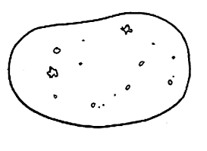
"Wonderful!!" said the old man. "You know, I once had stone soup with cabbage and some potatoes, and it was delicious!”.
Another villager gave the stranger some potatoes. . .

Slide 12
“And here you are some carrots” said other villager.

Slide 13
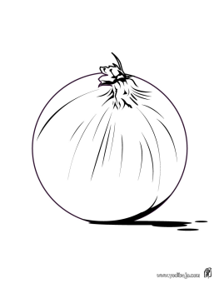
“Would you have some onions?” The old man asked.
A villager gave to him some onions.

Slide 14
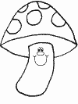
“And here you are some mushrooms” said another villager.

Slide 15
“Ohh!” Said the old man. “This soup will be delicious with some meat…”
The village butcher gave to the old man some meat.
And now they have a delicious meal for everyone in the village to share!

Slide 16
The villagers wanted to buy the magical stone but the stranger didn’t want to sell it and he left the village the next day.
It’s not a magic stone, you can make delicious soup working together.
THE END!

Slide 17
SONG

Slide 18
LISTENING
Do the shopping!
Children have a worksheet with different food
and the teacher names some of the different
food they have to buy, and children will do a tick
on the food that the teacher has said.

Slide 19
SPEAKING
Someone who likes….
Children are sit in a chair ring but there is one chair
left. The teacher says “someone who likes apples”
(for example) and those children who like apples
have to stand up, run and sit in a different chair.
Always there will be a student in the middle of the
ring because of the chair left and he or she has to
say “someone who likes (some food)” and so on.

Slide 20
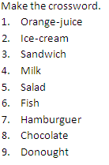
WRITING

Slide 21
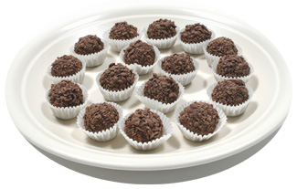
READING
Let´s cook!
Chocolate truffles
You need:
1 kg condensed milk
2 packets of cookies
250 g powdered chocolate
100 g chocolate noodles
Crush the cookies and mix them with the condensed milk, then add the powdered chocolate, stir it and mix it well.
When we have the mixture, form the dough into balls, then cover the balls with chocolate noodles and put them in a muffin mold.
We put the truffles in the fridge for two hours and then... have a good meal!

Slide 22
ORAL INTERACTION
Children, by working in pairs, have to ask «Do you like…? with all of the names of the
food and to put a tick or a cross depending on the answer of his or
her classmate.
Name

Slide 23
CUT-OUT

Slide 24
FINAL TASK
We are going to make truffles!
Let´s cook!
Chocolate truffles
You need:
1 kg condensed milk
2 packets of cookies
250 g powdered chocolate
100 g chocolate noodles
Crush the cookies and mix them with the condensed milk, then add the powdered chocolate, stir it and mix it well.
When we have the mixture, form the dough into balls, then cover the balls with chocolate noodles and put them in a muffin mold.
We put the truffles in the fridge for two hours and then... have a good meal!

Slide 25
GOODBYE SONG
Everyone gets on their coats, On their gloves, On their hats, Everyone gets on their coat, It's time to go home!
Oh it's time to say goodbye, say goodbye, say goodbye
Oh it's time to say goodbye, goodbye to all of you!

